Slide 1
P-train project update 4
Tuyen Nguyen
Miek Adriaens

Slide 2
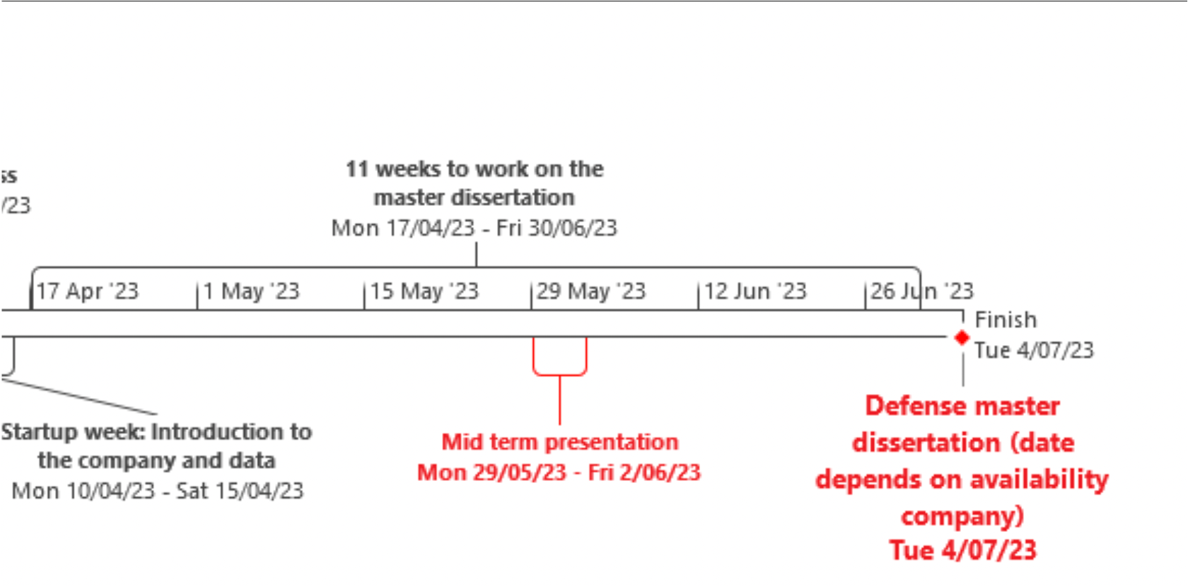

Planning (1)

Slide 3
Planning (2)
May 1-7:
Reworked XGBoost model approach to single P-train impact
Made train network to use as features
May 8-14:
XGBoost continuation, refine, add new features (Graph-NN)
Plan & implement dynamic/personalised features for the P-trains
May 15-21:
Calibration testing, exploring feasibility of percolation, forestfire and simulation models
May 22-28:
May-June 29-4: Mid term presentation
June 5-11:
June 12-18:
June 19-25:
June-July 26-30: finalising
July 3-7: Defence

Slide 4
P-train Punctuality Project
We are working with the trains punctuality and journey data
Central questions:
What impacts do P-trains have?
What makes a good P-train?
What makes a bad P-train?
If we create a new P-train, will it be good or bad?

Slide 5
We will quickly go over our previous, flawed approach before we will discuss our newer, better approach

Slide 6
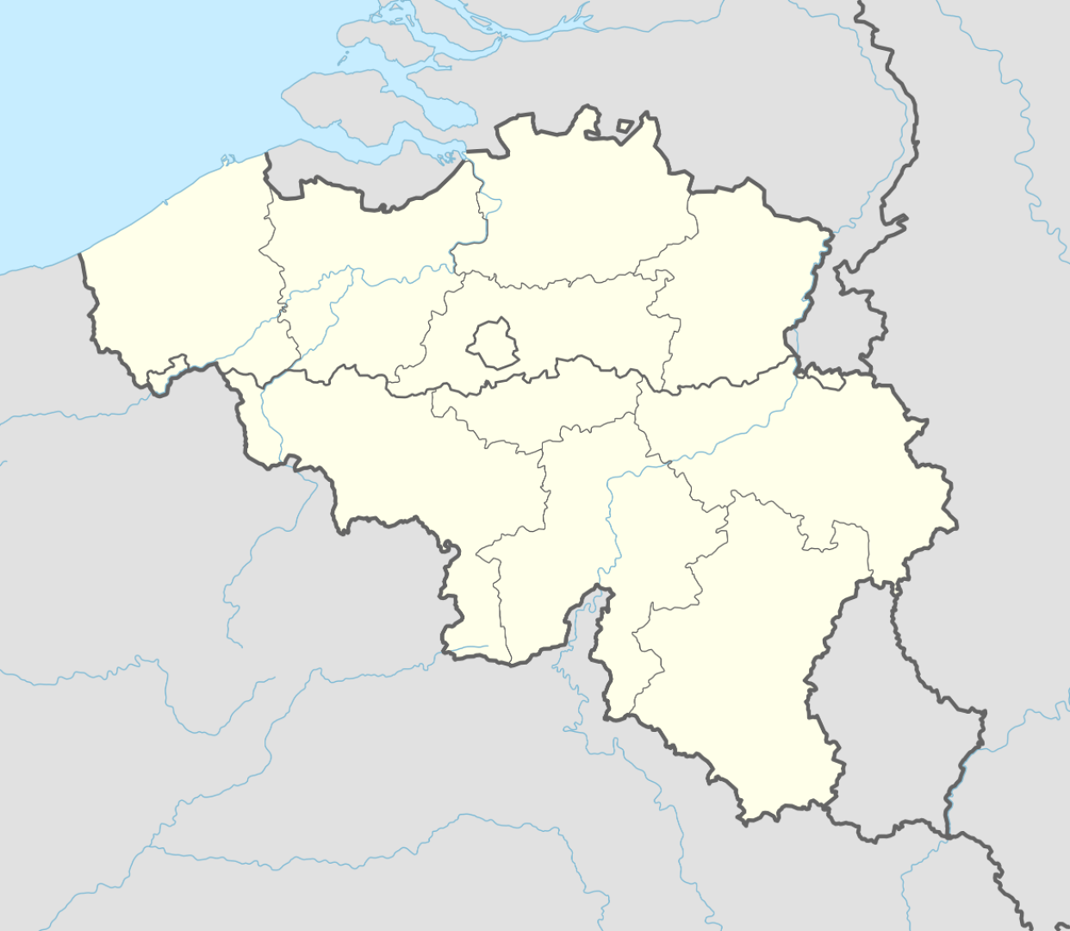
Old Approach:
In the morning of 16/3

Slide 7
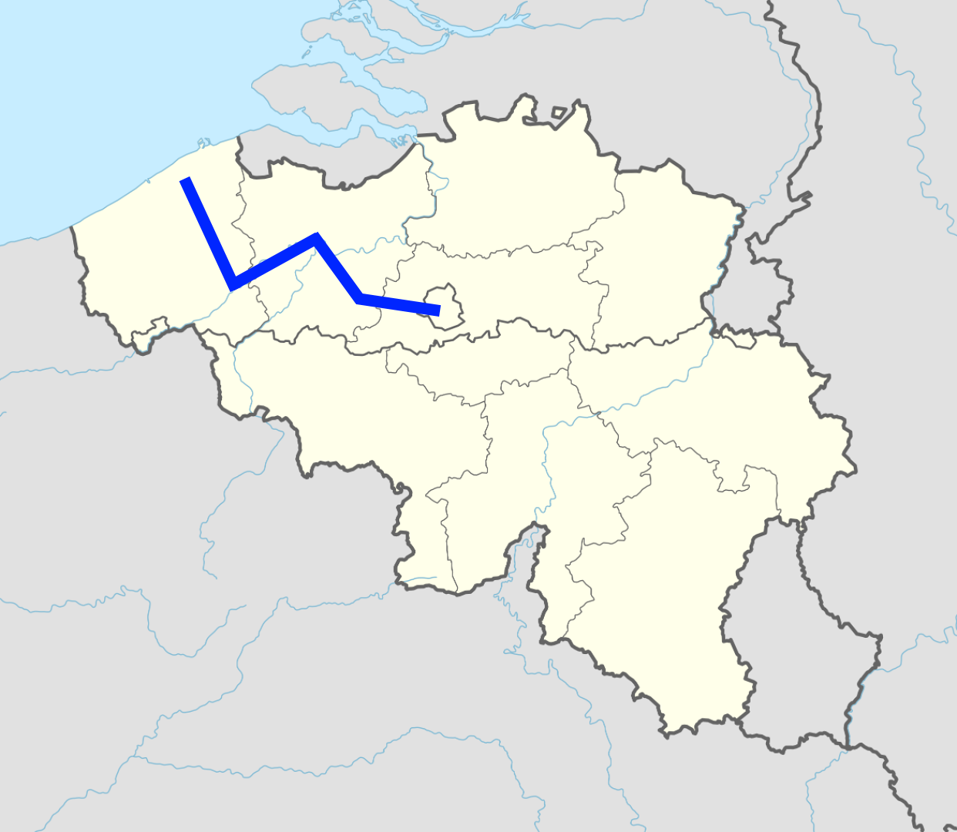
Old Approach:
In the morning of 16/3
For this line

Slide 8
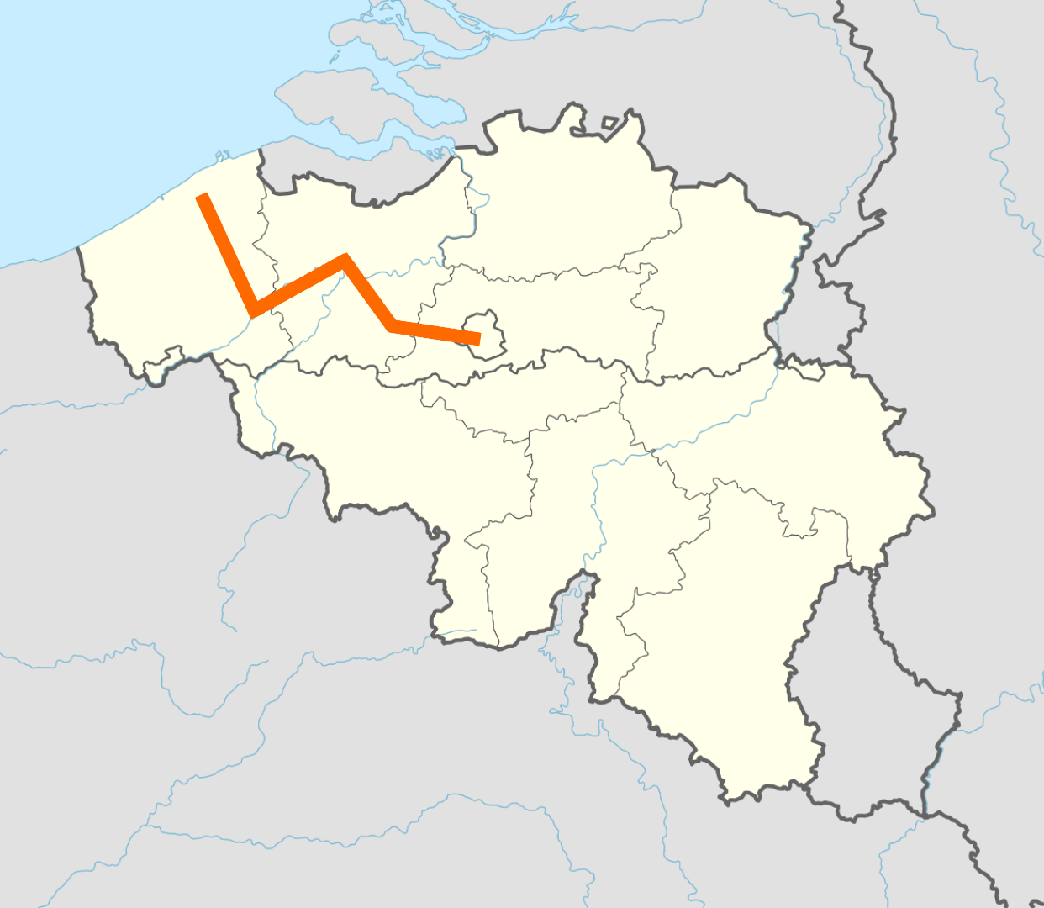
Old Approach:
In the morning of 16/3
For this line
Train 1
whole journey on the line

Slide 9
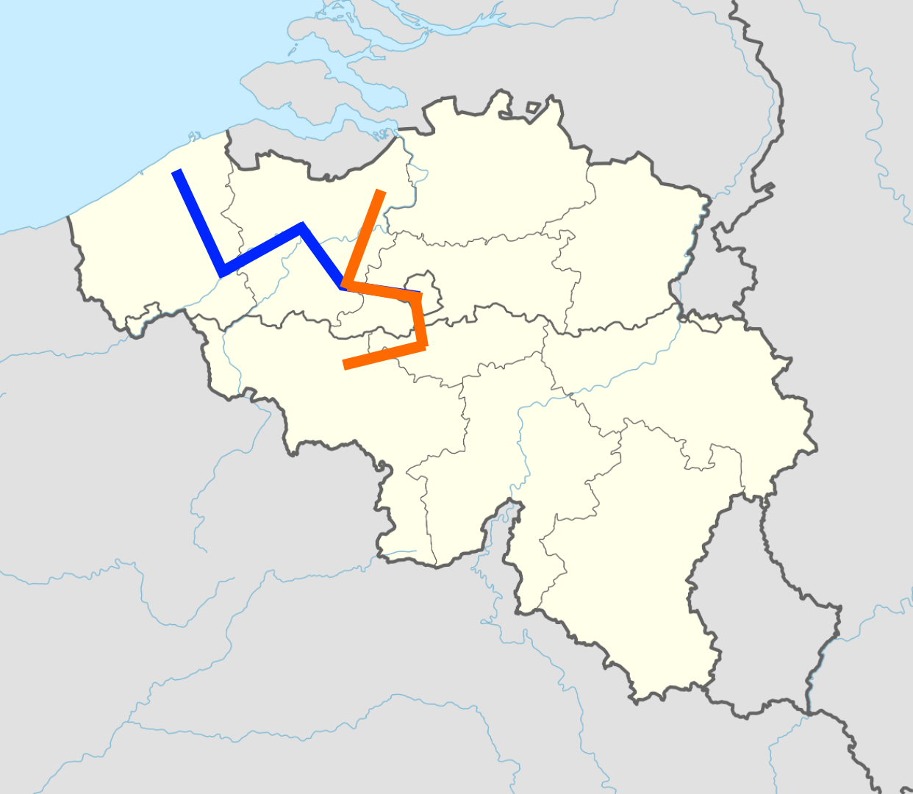
Old Approach:
In the morning of 16/3
For this line
Train 1
Train 2

Slide 10
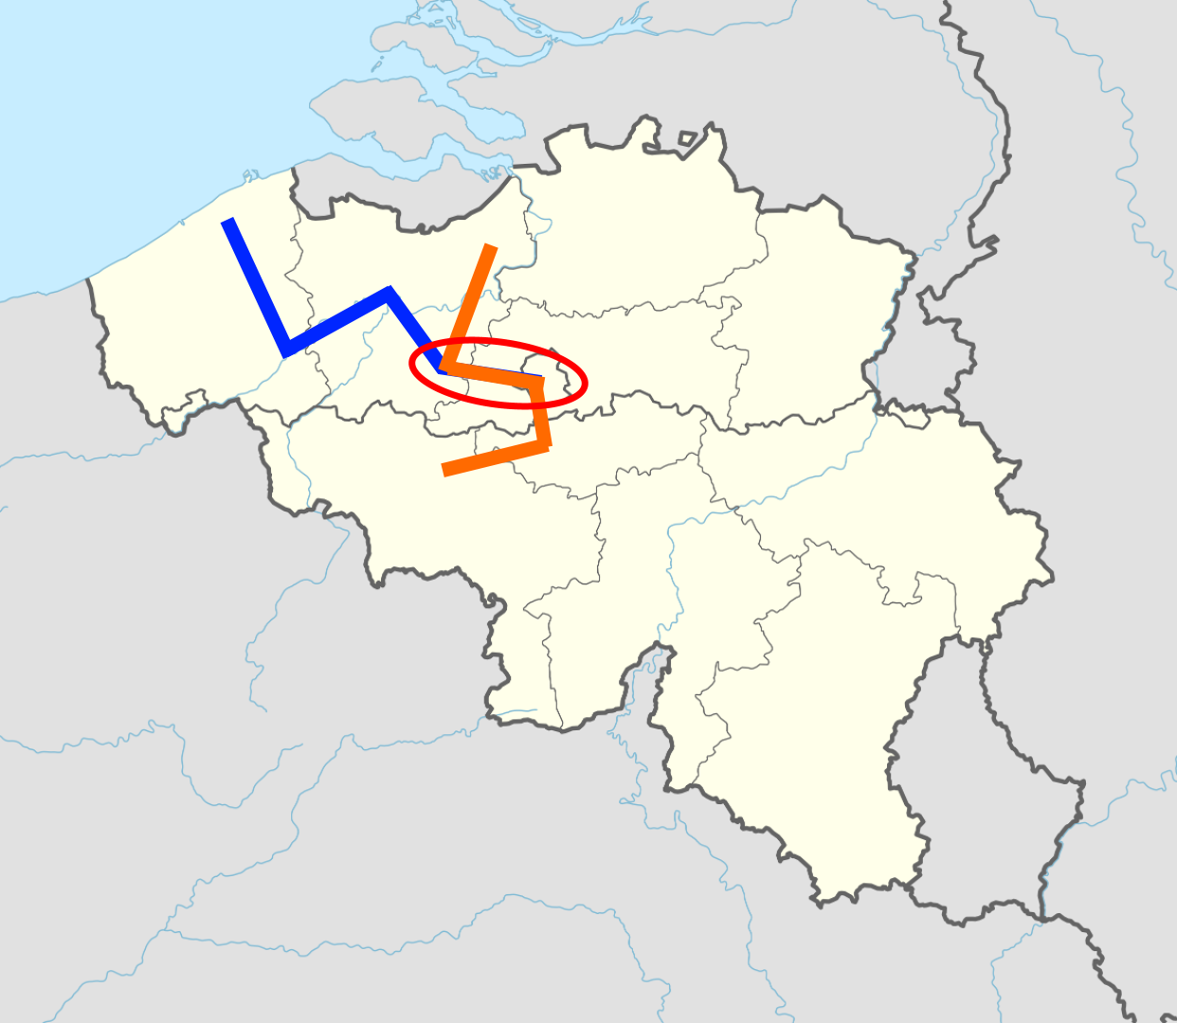
Old Approach:
In the morning of 16/3
For this line
Train 1
Train 2
2 stops on the line

Slide 11
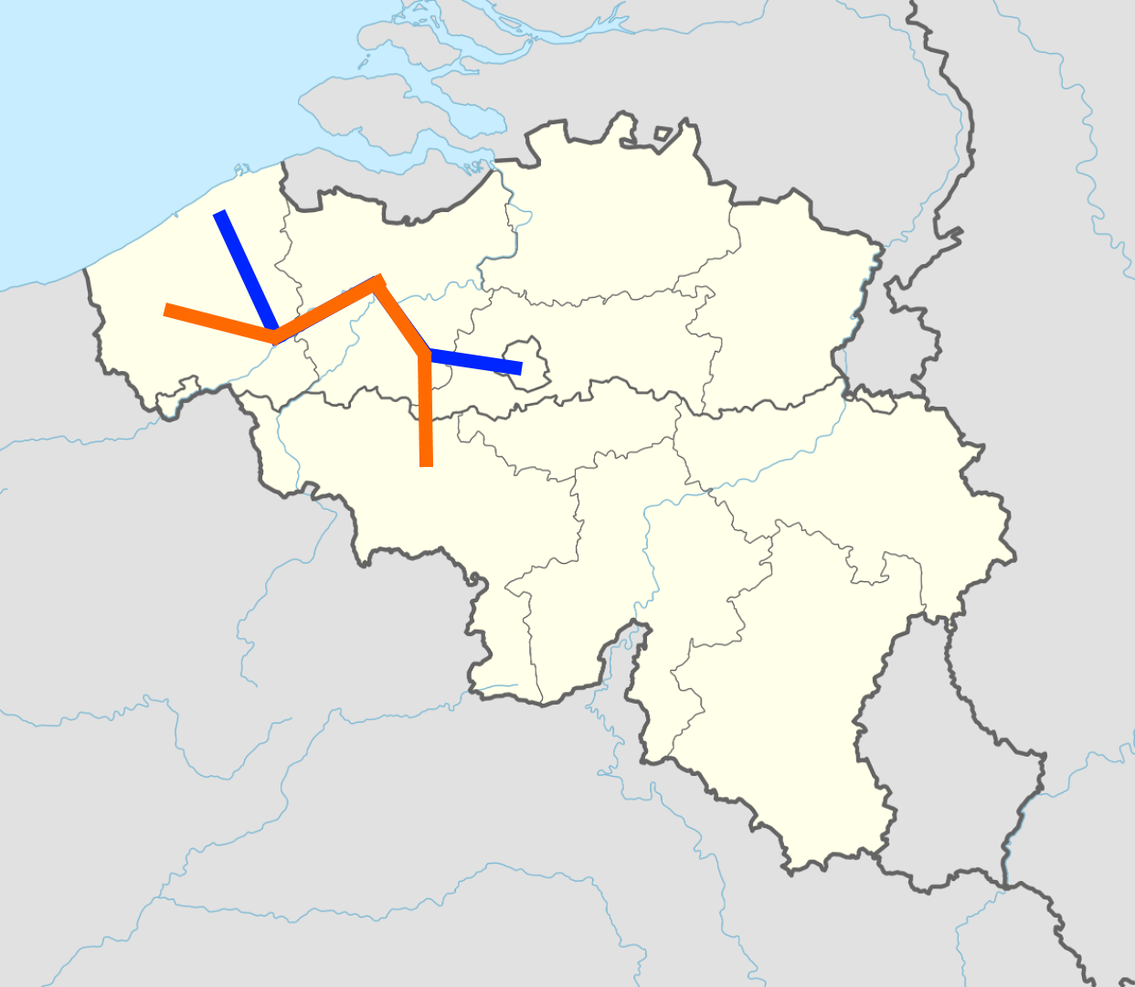
Old Approach:
In the morning of 16/3
For this line
Train 1
Train 2
Train 3

Slide 12
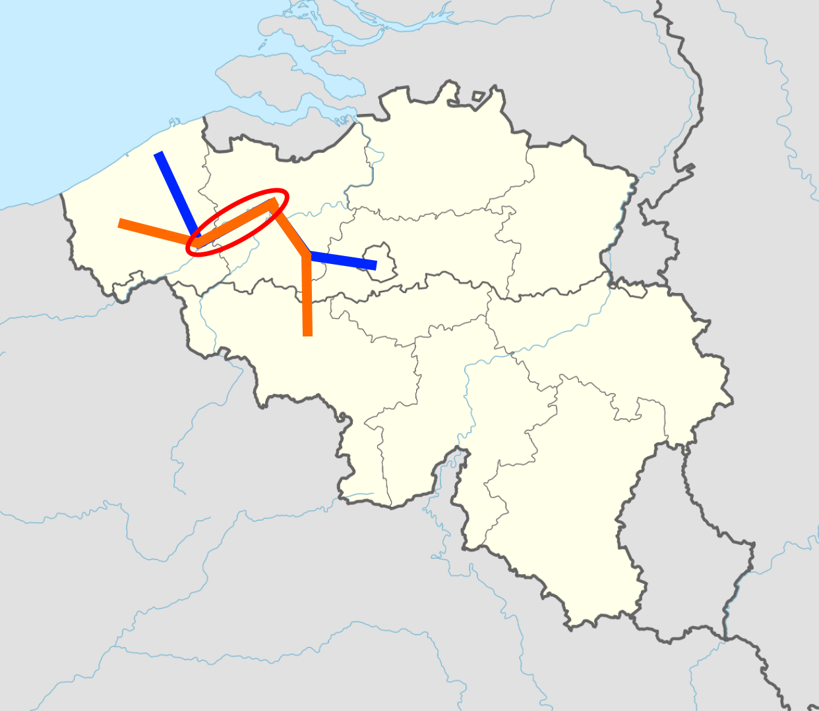
Old Approach:
In the morning of 16/3
For this line
Train 1
Train 2
Train 3
has three stops on the line

Slide 13
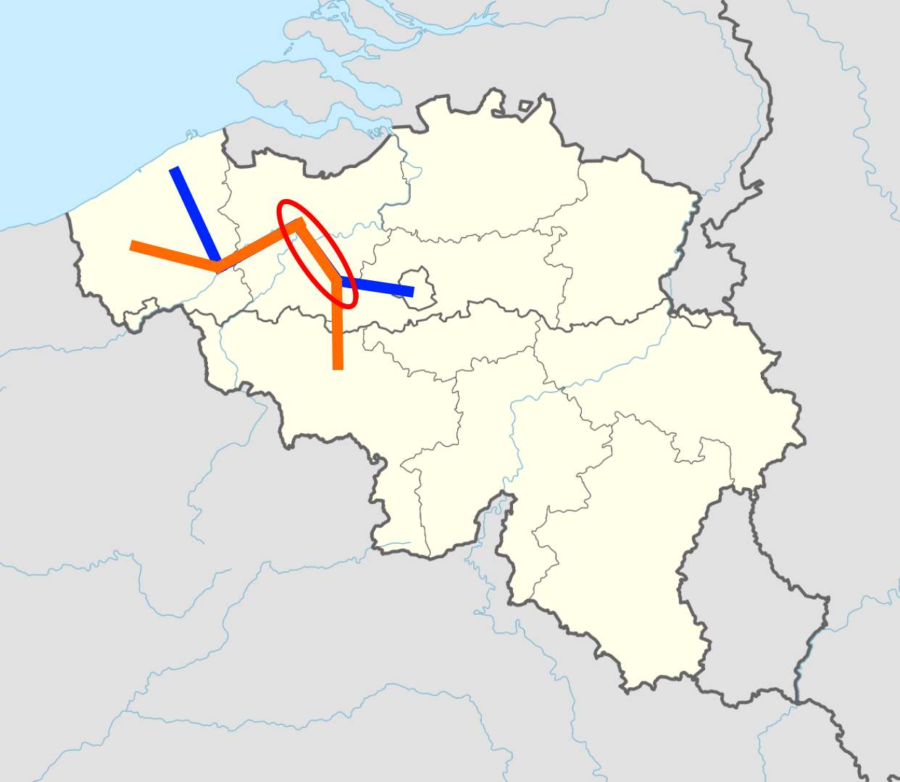
Old Approach:
In the morning of 16/3
For this line
Train 1
Train 2
Train 3
has three stops on the line

Slide 14
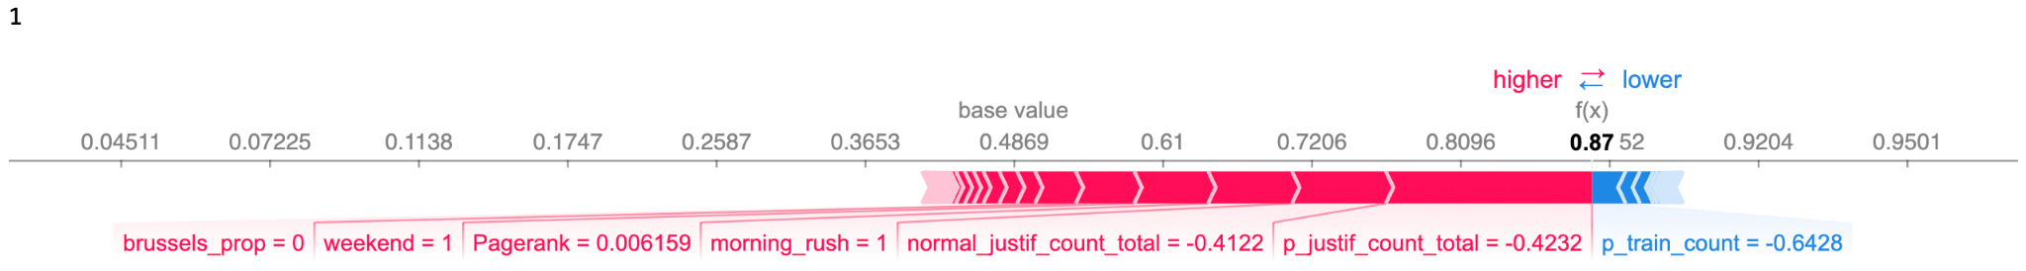
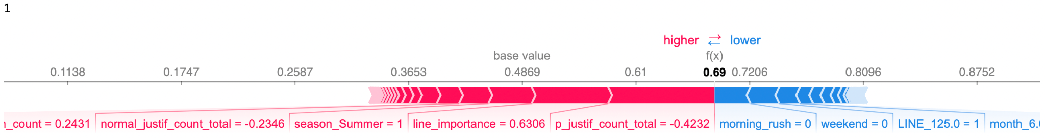
Old Approach:
Target: Was the service level of 90% met for all trains in consideration?
2 out of 3 on time: 66% < 90% -> service level not met -> target gets a 0
3 out of 3 on time 100% > 90% -> we meet the service level -> target gets a 1
actual value
actual value

Slide 15
New Approach:
From feedback of last week: model should focus more on impact of P-train
Goal: what is the impact of a particular P-train on the network

Slide 16
New Approach:
Impact (target): Did a P-train cause another train to be late? (>6 mins):
Direct: P-train is the responsible train
Indirect: a knock-on delay originated by a P-train
Any time the train causing the delay itself was also recently delayed, we shift the blame back to the train causing that earlier delay.
We attribute the delay to the train that is ultimately responsible
explained visually:

Slide 17
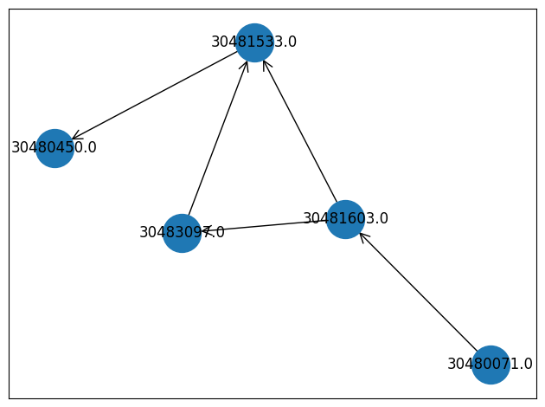
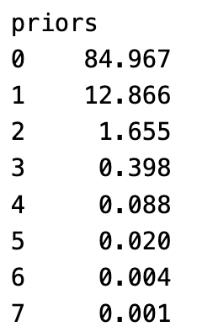
Target Variable
Direct Impact:
Indirect Impact:
7001
3003
Within 5 minutes
Direct impact
Within 5 minutes
Direct impact
Within 30 minutes
Direct impact
3003
7001
5001
5002
Within 5 minutes
Direct impact
Within 5 minutes
Direct impact
Indirect impact
7002
Notes:
Add % of P-trains that were delayed themselves

Slide 18
Target Variable
Direct Impact:
Indirect Impact:
7001
3003
Within 5 minutes
Direct impact
Within 5 minutes
Direct impact
Within 30 minutes
Direct impact
3003
7001
5001
5002
Within 5 minutes
Direct impact
Within 5 minutes
Direct impact
Indirect impact
7002
Notes:
Add % of P-trains that were delayed themselves

Slide 19
Comparing Old and New Approach
 | Old model | New model
Target | Did trains in a rush period that all pass at least 1 station on a particular line meet the service level? | Did a particular P-train make another train late?
Variables | Group of trains, line network | Single P-train,

Slide 20
METHODOLOGY

Slide 21
Variables
No | Time variable | Train-specific variable | Network variables
1 | YEAR_DEP | TRAIN_NUMBER (One-hot-Encoding) | Degree
2 | month | station_XXX (One-hot-Encoding) | Closeness centrality
3 | season | stations_count | Peak train level of importance (Page rank)
4 | weekend
5 | holiday
6 | dep_hour_origin
7 | ​​day_origin
8 | date_origin
9 | rush

Slide 22
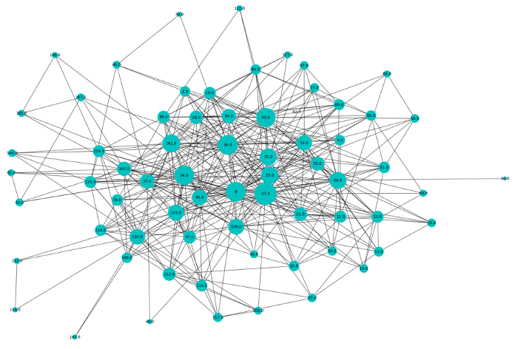
Network Variables
Node: Trains
Edge: If train A & B share a stop

Slide 23
Network Variables
•Weighted Degree / Strength
number of common stops a train has with other trains
•Centrality
Measures average of shortest paths in the network to every other trains
•Pagerank
trains that share common stops with many other trains are more important themselves
Current drawback: Static graph network variable
Future improvement: Dynamic network variable

Slide 24
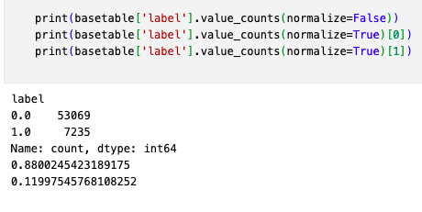
Class Imbalance
Current approach:
Stratification
Reweighting positives
(SMOTE)

Slide 25
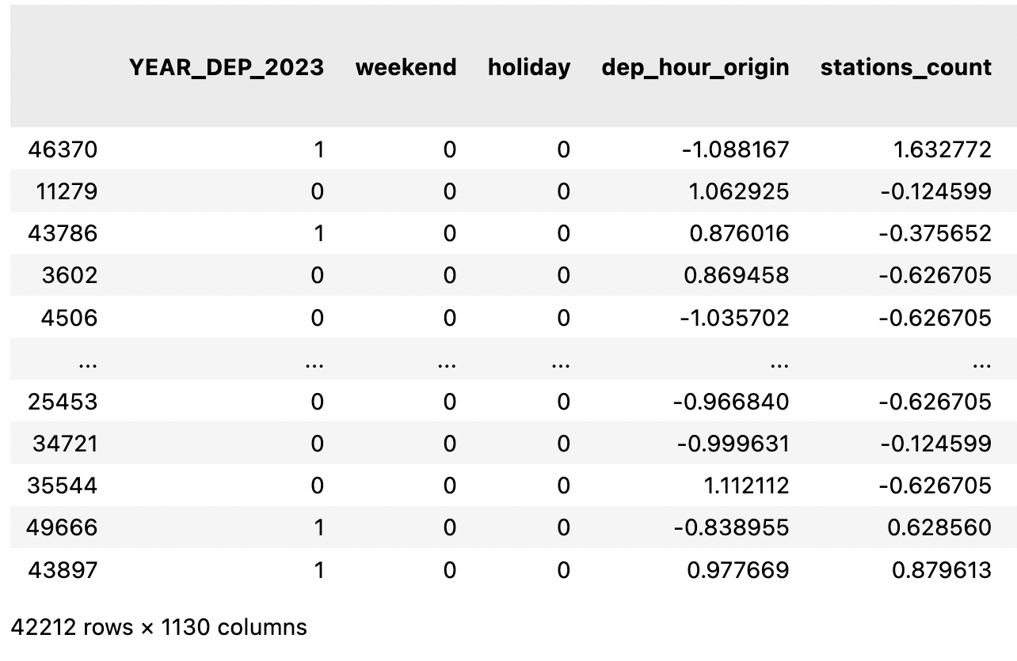
High Dimensionality
14 variables but 1130 dimensions because of OHE variables
Option 1: Reduce Dimensionality
Lose interpretability
Option 2 (preferred): Keep Dimensions

Slide 26
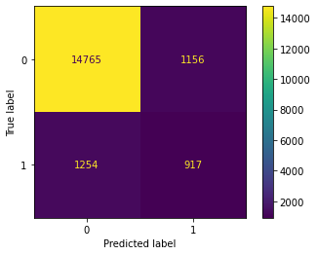
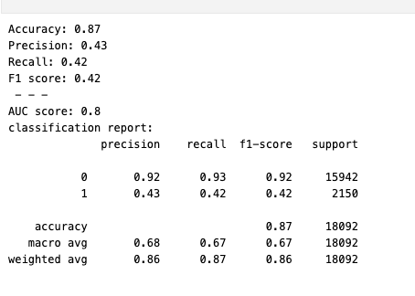
Evaluation Metrics:
Future approach: find more predictive variables
(Starting/ending stations, weather, etc..)

Slide 27
Preliminary Results

Slide 28
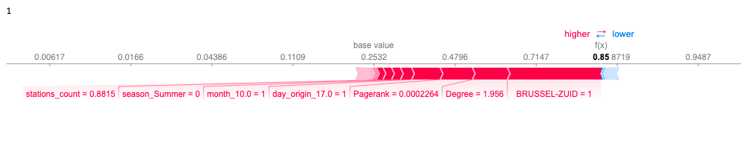
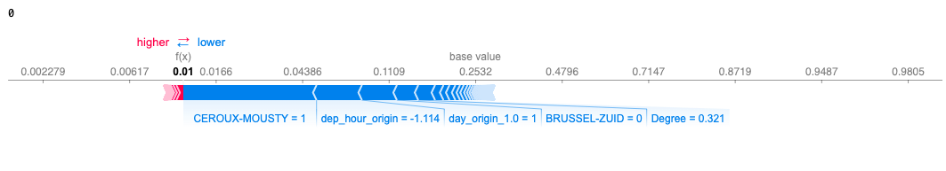
Example of Currents Predictions:
actual value
actual value

Slide 29
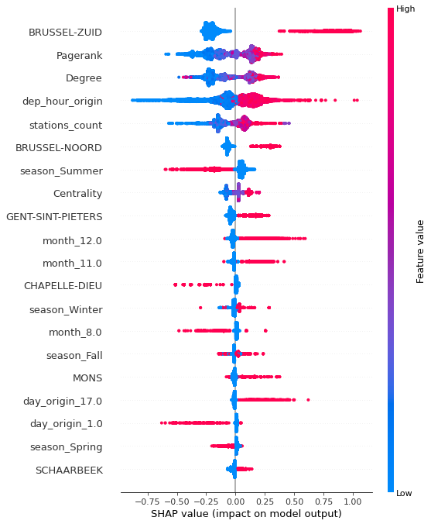
SHAP values for current model:
points to the right mean higher chance of P-train having a negative impact

Slide 30
Closing: Q&A
Do you see any issues?
What are your views on the variables?
Which variables do you think are good/bad?
Which variables do you think we can add?
Our next steps:
more variables (population, # tracks, # signals, # Y-splits / crossings)
making network variables dynamic per train

